Slide 1
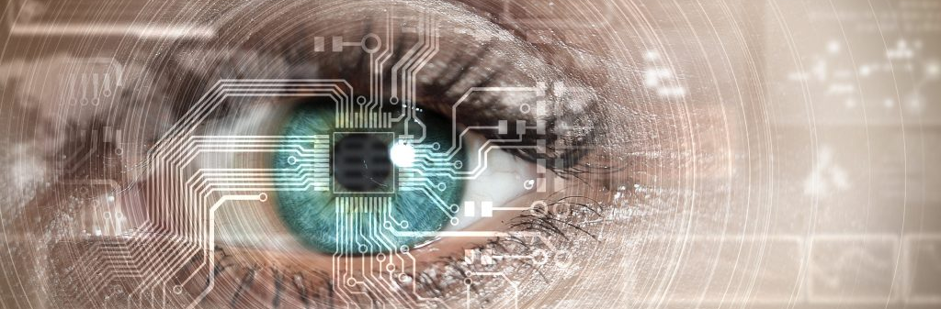
AI Computer Vision, From Zero to Hero in less than 2 hours
KNOWLEDGE NETWORKING SESSION SERIES

Slide 2

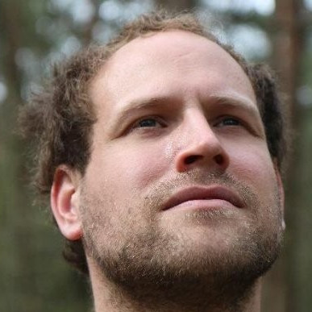

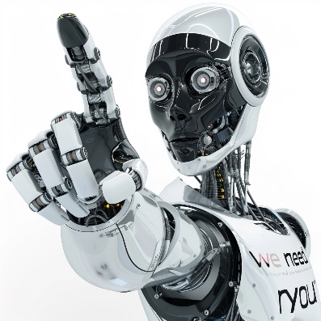
How are we ?
Pauwel
Eddy Boonen
We Need You
Senior Architect – AI Lead
CGI Belgium – E&U
Director Consulting Expert
CGI Belgium – Private Companies
This is an interactive workshop so we need you !

Slide 3

Objective of today’s session
Introduction in Google Colab
Introduction in ML
Built your first image classification
From Zero to Hero

Slide 4

Agenda
01
Introduction to GOOGLE COLAB
02
Intro to Machine Learning
03
Demo Machine Learning Workflow
04
Basic Computer Vision with ML
05
Introducing Convolutional Neural Networks
06
Building an image classifier

Slide 5

Before we start
Lets’s have a look (and set up Colab). Colab is a hosted Jupyter Notebook service that requires no setup to use and provides free access to computing resources, including GPUs and TPUs.

Slide 6


Slide 7
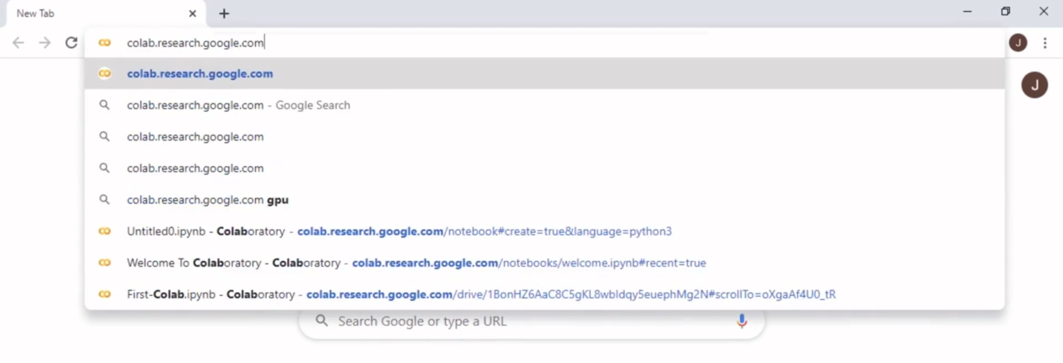
https://colab.research.google.com/

Slide 8
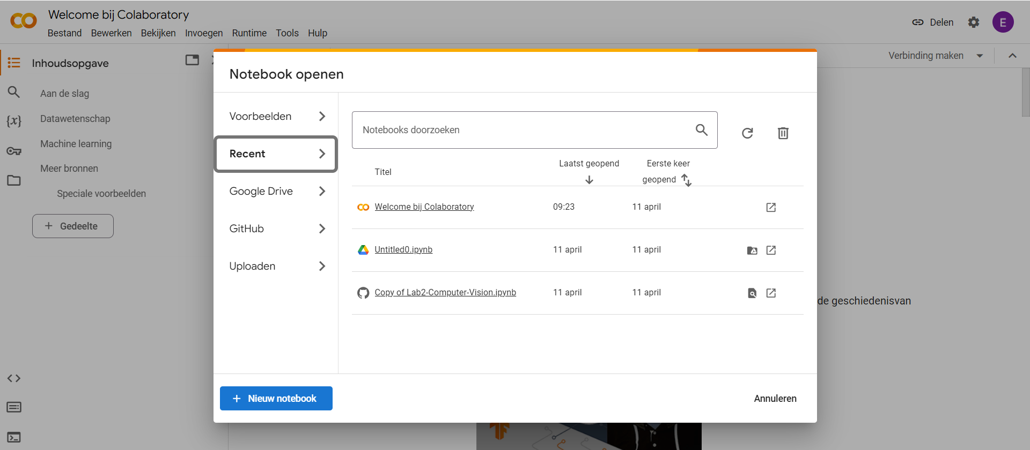

Slide 9
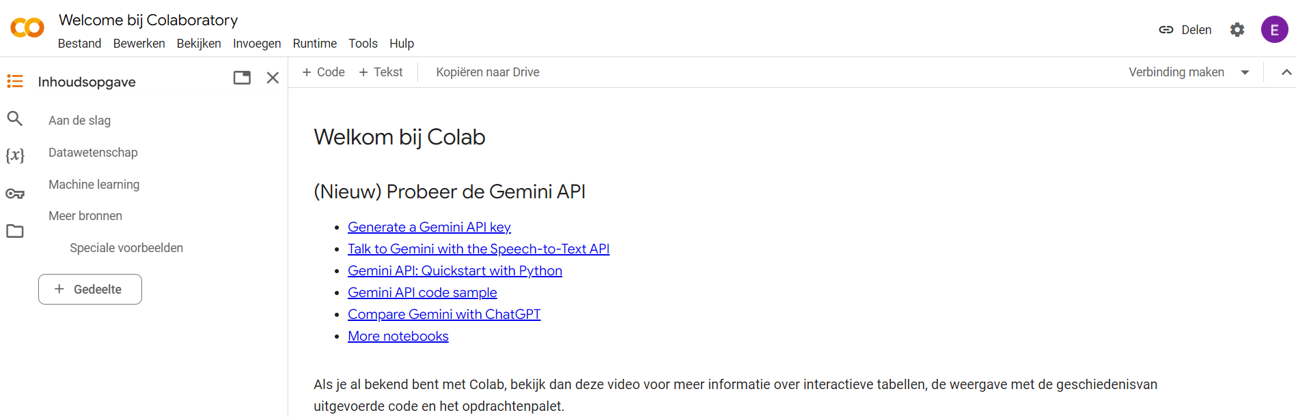
To create more space click the “x”

Slide 10
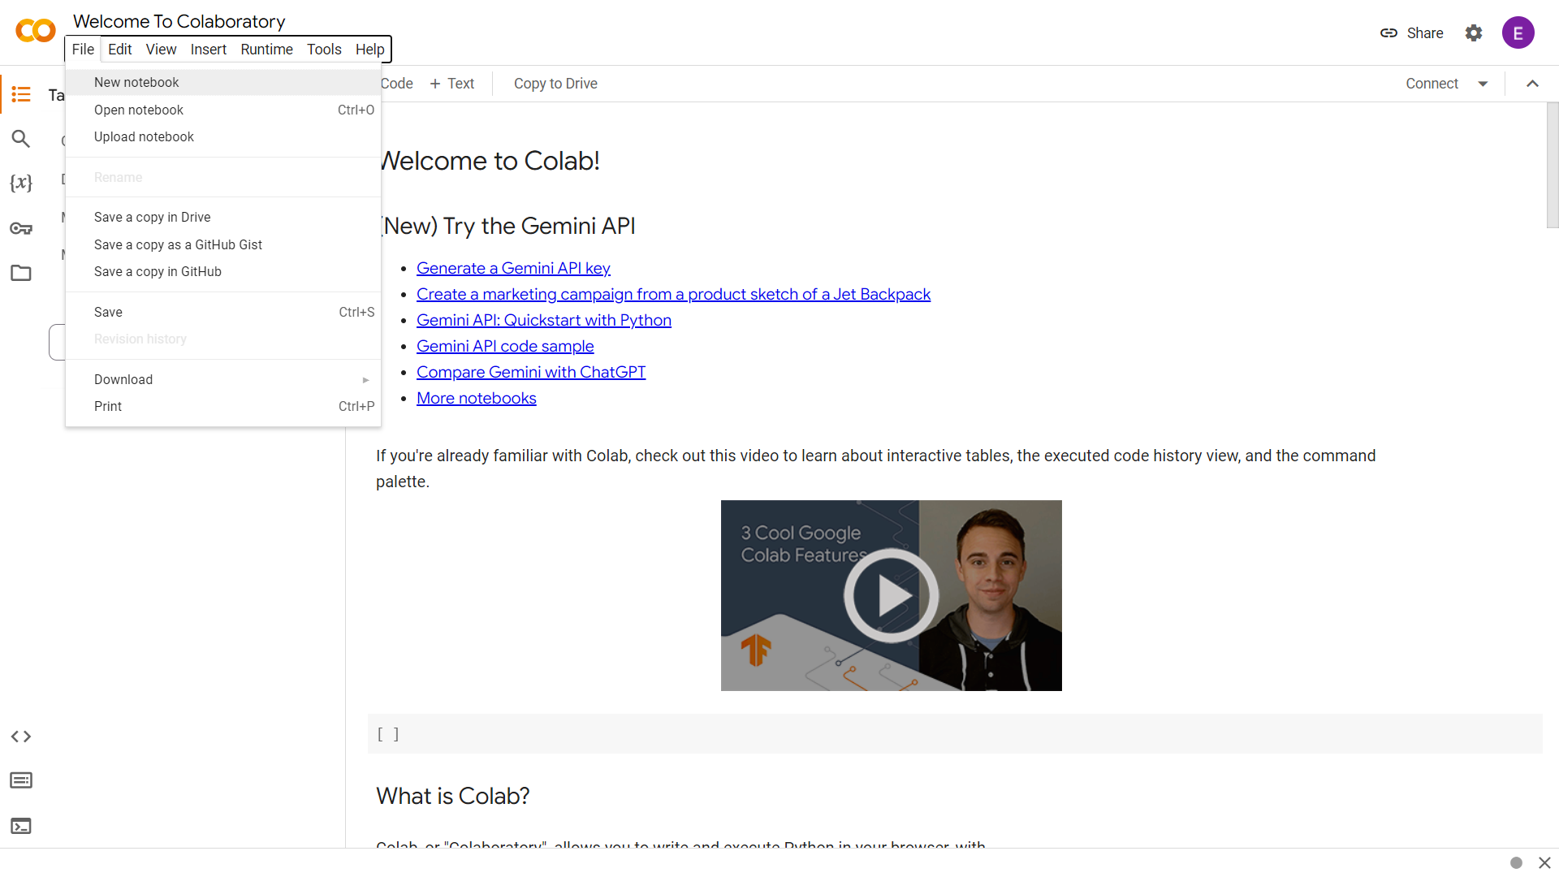
To create a new notebook

Slide 11
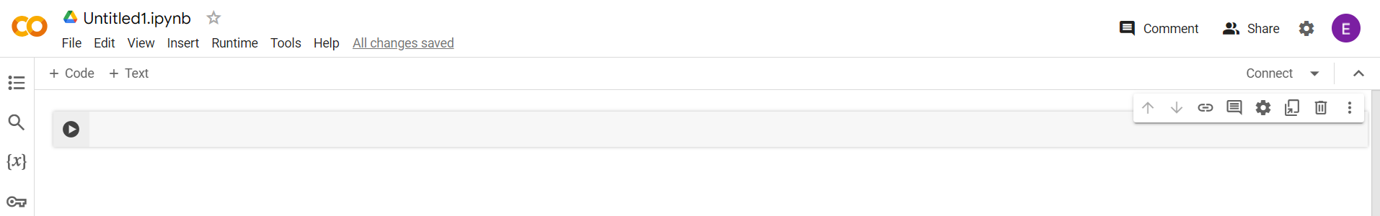
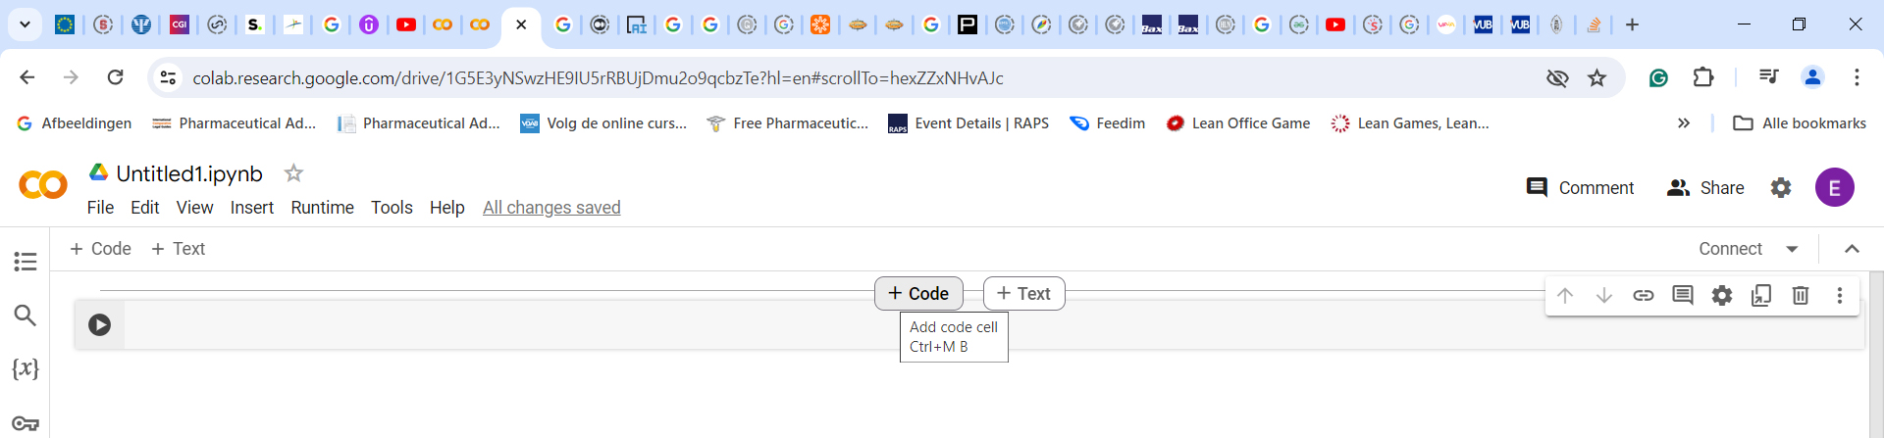

Slide 12
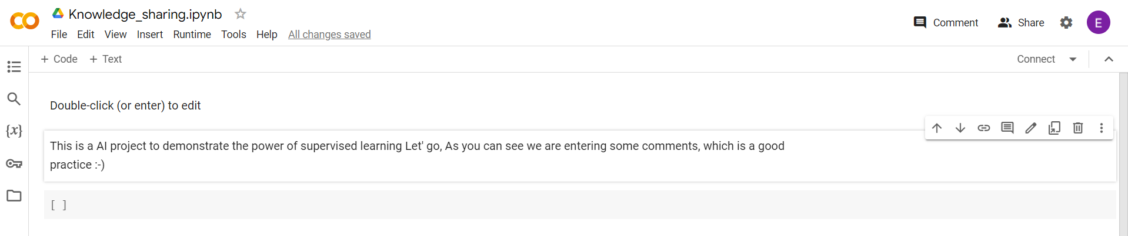
Change the name
Add some comments

Slide 13
Import TensorFlow / Numpy
TensorFlow is an open-source software library for machine learning, developed by researchers and engineers from the Google Brain team. It is designed to facilitate the creation of complex neural network models and algorithms, and it supports a wide range of tasks from training basic machine learning models to deploying complex deep learning systems.
NumPy, short for Numerical Python, is a fundamental package for scientific computing in Python. It provides support for large, multi-dimensional arrays and matrices, along with a large collection of high-level mathematical functions to operate on these arrays.

Slide 14
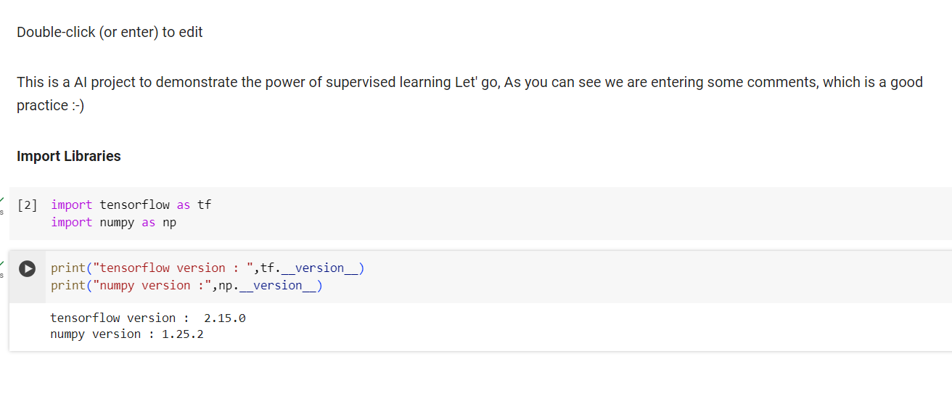

Slide 15

Setting up the TensorFlow Environment
1 | Create (our use an existing) Google account
2 | Pay 0 euro
3 | Download and install nothing
4 | Go to colab.research.google.com

Slide 16

Using Jupyter Notebook
1 | Create text cells using markup for documentation
2 | Double-click a text cell to edit it
3 | Create code cells for Python code
4 | Send a cell to the server for executing by clicking on the run arrow (or Shift + Enter)

Slide 17
Using Jupyter Notebook
5 | Running the code in a cell executes that cell in the context of any prior executed cells
6 | Use the sequence numbers in brackets to see the current execution order
7 | Use “Run All” to run all Notebook code from the top down
8 | Use “Restart and run all” to clear the state and then run all Notebook code from the top down

Slide 18
INTRO TO ML
programming computers to optimize a performance criterion using example data or past experience

Slide 19
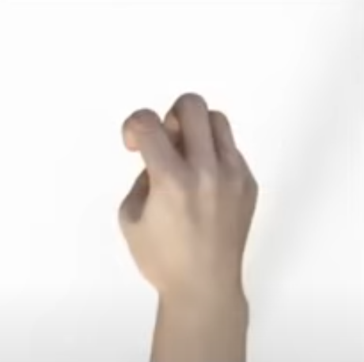
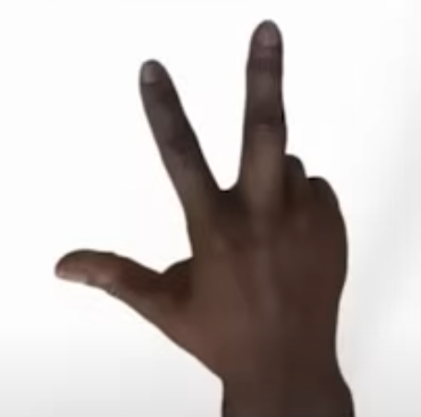
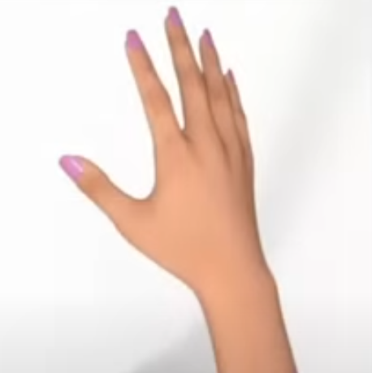
Rock, Paper Scissors

Slide 20

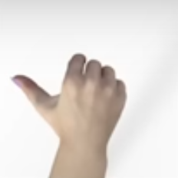

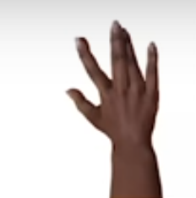
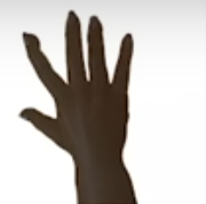
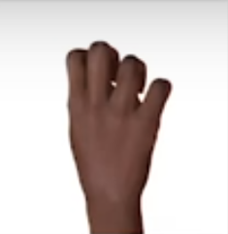
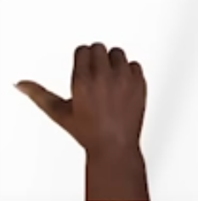

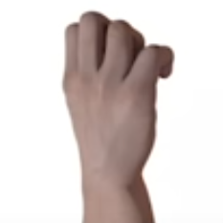



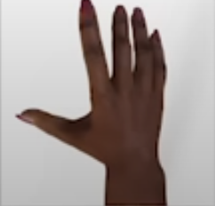
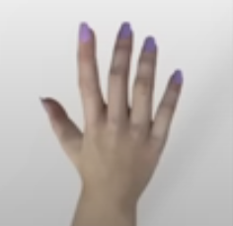

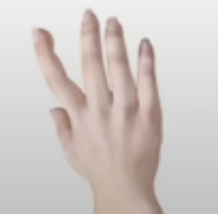
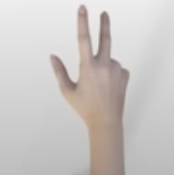
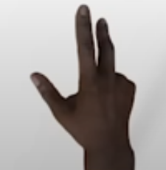
Rock, Paper Scissors

Slide 21
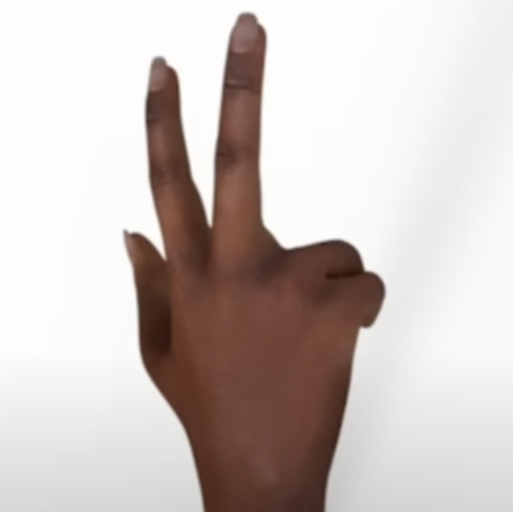
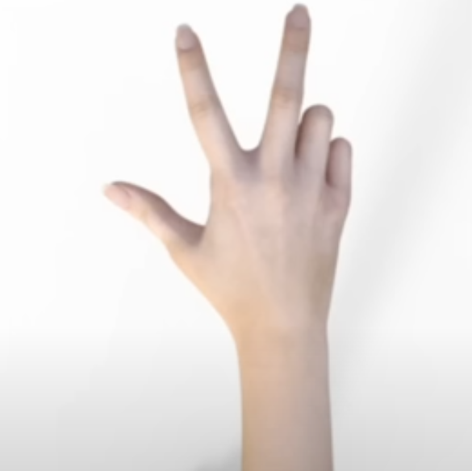
Rock, Paper Scissors

Slide 22
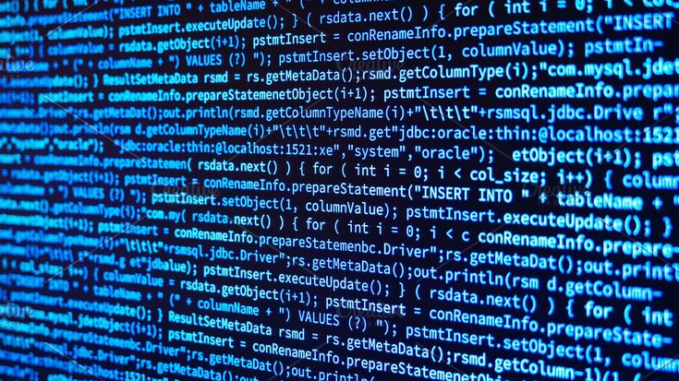

Slide 23
Traditional Programming vs ML
Traditional Programming
RULES
ANSWERS
DATA
Machine Learning
ANSWERS
RULES
DATA

Slide 24

Neural Network — Explained with a simple story
“Once you stop learning you start dying” — Albert Einstein
Once upon a time there lived a beautiful brilliant girl. She lived with lots of dreams and wanted to achieve a lot in her life.
She decided to try one examination to get scholarship for her studies. If she gets the scholarship, she can study more to pursue her dreams.
Notes:
Just started with Neural Networks and confused with the below terms?
Training
Forward and Backward propagation
Loss Function
Optimization
Weights/Parameters
Epochs
Overfitting
Lets try to figure out all these terms and what is going on inside a neural network using a simple story.
============================================================

Slide 25

Neural Network — Explained with a simple story
“Once you stop learning you start dying” — Albert Einstein
She got one book from her friend to study for the examination. She made some commitments to herself to wake up at 5AM everyday and read the book.
The book had 100 practice questions and solutions in the end.
She read the entire book in a couple of days and tried to answer all the questions. Feeling so happy, she started self evaluation by comparing her answers with the the solutions provided in the book.
And she got 75 correct answers out of total 100.

Slide 26

Neural Network — Explained with a simple story
“Once you stop learning you start dying” — Albert Einstein
“Ok, I made 25 mistakes, let me see where I failed” She said. She started analyzing her mistakes and figured out that, she should have given more priority to some topics to get better marks.
She again started reading the book by changing her priorities of topics. In the end she again tried to answer all questions and compared the results. Wow its better now, 83 correct answers. She was so happy.
She did the analysis of her studies again and changed her priorities.
She started studying again and did the self examination, her score improved to 95 now.

Slide 27

Neural Network — Explained with a simple story
“Once you stop learning you start dying” — Albert Einstein
Yes, she did not give up, she kept on doing the same process again and again till she got 100 out of 100 and she started jumping with happiness.
Now she said to herself, “I got 100% and I am ready for the exam”.
The exam day came, with high confidence she attended the exam and anwered all questions. She expected 100% in her test and started waiting for the results.

Slide 28

Neural Network — Explained with a simple story
“Once you stop learning you start dying” — Albert Einstein
Finally, the result came. Her eyes filled with tears, yes she failed. She got only 60%. She needed at least 75% to pass the exam. She felt so hopeless.
But then she thought, there is no point in crying. Let me see if I can learn something from my failure. “Failure is the stepping stone of Success” she knows.
She analysed her study plan, and figured out the mistake she made. She just memorized everything from the book, rather than learning the concepts.

Slide 29

Neural Network — Explained with a simple story
“Once you stop learning you start dying” — Albert Einstein
She adjusted her study method; she started understanding the concepts. In her self evaluation she got 96 correct answers. And she attended the final exam again, she was able to score 95% and passed the exam.
Yes, she got the scholarship and started pursuing her dreams.

Slide 30
Neural Network — Explained with a simple story
“Once you stop learning you start dying” — Albert Einstein
The girl in this story represents our Neural Network model. The model we finally want to build for predictions.
The book she used is the data we have. We build a model using the data.
“She read the entire book in couple of days” — We feed the data into the network and reached the last layer.
“She started self evaluation by comparing her answers with the solutions provided in the book” — In neural network, after each epoch, we also have to do an evaluation to see how good our model is. A Loss function will be used to calculate how far the predicted results from actual results. A lower loss function value means the model is good. “And she got 75 correct answers out of total 100” — 25 mistakes she made is the loss.
Once we get the loss value it means one forward propagation through the network is done.
“Ok, I made 25 mistakes, let me see where I failed” She said. She started analysing her mistakes” — Here she is trying to reduce her loss by optimizing her study plan. In neural network we use Optimization methods (Eg. Gradient Descent) to reduce the loss function values.
Notes:
You might have already figured out how this story relates with Neural Networks. But let me explain.

Slide 31
Neural Network — Explained with a simple story
“Once you stop learning you start dying” — Albert Einstein
“and figured out that, she should have given more priority to some topics to get better marks” — Here priority represents the weights/parameters of all layers in neural network.
“She again started reading the book by changing her priorities of topics” — Finding new weights/parameters with the optimization is done by backward propagation. (We are propagating backwards through the network to find the new weights). Once we are done with forward and backward propagations of the entire data, we call it 1 epoch of neural network. “She again started reading the book” — Starting new epoch with new weights.
“Yes, she did not give up, she kept on doing the same process again and again till she got 100 out of 100” — We keep on training the network till we get very high accuracy or very low loss value on the training data.
“Yes she failed. She got only 60%. She just memorized everything from the book, rather than learning the concept” — Yes this is one of the most common problem happening with neural network which is called overfitting. Overfitting to the training data and it gets very poor performance on real world data. Network will memorize all patterns from training data and not able to generalize well on different set of data. We can avoid overfitting by using less complex network or methods like Dropout, Regularization etc..
Notes:
You might have already figured out how this story relates with Neural Networks. But let me explain.

Slide 32
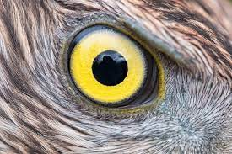
Neural Network — Explained with a simple story
“Once you stop learning you start dying” — Albert Einstein
“she was able to score 95% and passed the exam” — Finally the network performed well on test data.
Is it enough? We got a very good model and we can use the same model forever? Is it true?
Albert Einstein said “Once you stop learning you start dying”. Yes it is true for neural networks as well. 😃 Periodically we will have to monitor the model’s performance on new data and retrain the model if needed.
I hope this gave you a bird’s eye view on neural network concepts.
Notes:
You might have already figured out how this story relates with Neural Networks. But let me explain.

Slide 33
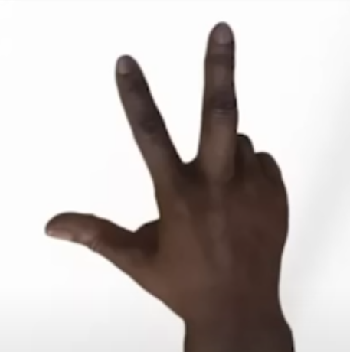
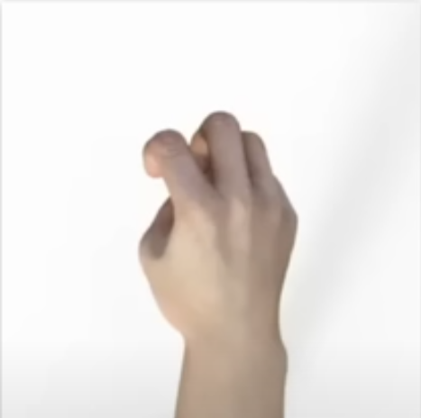
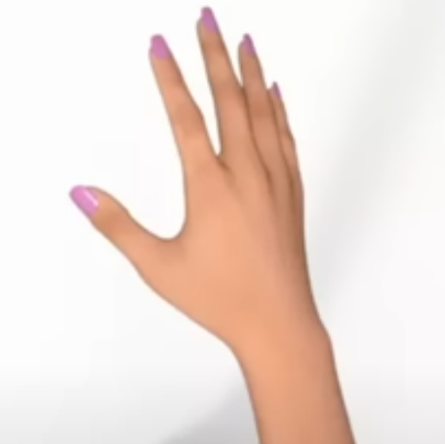
Data and Labels
Data
Data
Data
10001100101111010101100100110000100011001110011110010100101010001011100011100110
10001100101111010101100100110000100111011001010010101000101111000101001111100110
111000111100111100001010100100000101001100011101100010111001001110001111110011001
Label = Scissors
Label = Rock
Label = Paper

Slide 34
A simple example
Y
X = -1, 0, 1, 2, 3, 4
Y = -3, -2, 1, 3, 5, 7
Y = 2X - 1

Slide 35
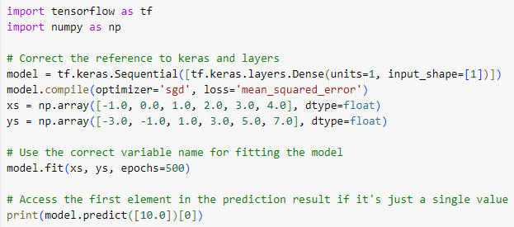
Python Code
First line defines the model itself
Notes:
Single neuron, Single value

Slide 36
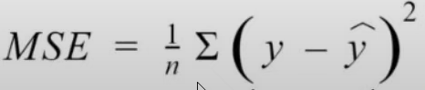
Loss functions (/cost function /error function)
model.compile(optimizer='sgd',loss='mean_squared_error')
Quantifies the error between output of the algorithm and a given target value.
0,50
0,50
0,45
0,45
x2,y2
0,40
0,40
error
0,35
0,35
0,30
0,30
x1,y1
0,25
0,25
Error = y2 – y1
0,20
0,20
0,15
0,15
0,10
0,10
0,1
0,2
0,3
0,4
0,5
0,1
0,2
0,3
0,4
0,5

Slide 37
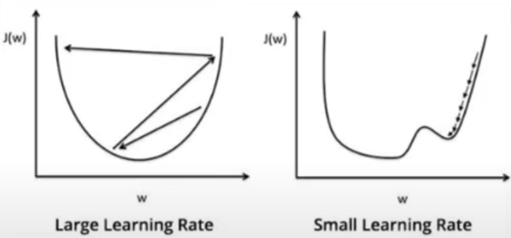
What are optimizers
model.compile(optimizer='sgd',loss='mean_squared_error')
Optimizers update the model in response to the output of the loss function
Optimizers assist in minimizing the loss function
Gradient Descent
Loss
Learning step
minimum
Weight (Slope)

Slide 38
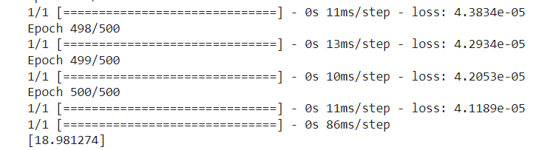
A much simpler example
X = -1, 0, 1, 2, 3, 4
Y = -3, -2, 1, 3, 5, 7
Y = 2X - 1
Y = (2 * 10 – 1) = 19

Slide 39
ML Workflow
Define which phases are implemented during a machine learning project

Slide 40
Machine Learning Workflow
1
2
3
4
5
6
Define
Problem
Prepare
Data
Create
Model
Train
Model
Evaluate
Model
Get Data
Lets explain this using a real example “House Price Prediction”.
Sources :
AmesHousing-05-2010.csv
House_price_regression.ipynb

Slide 41
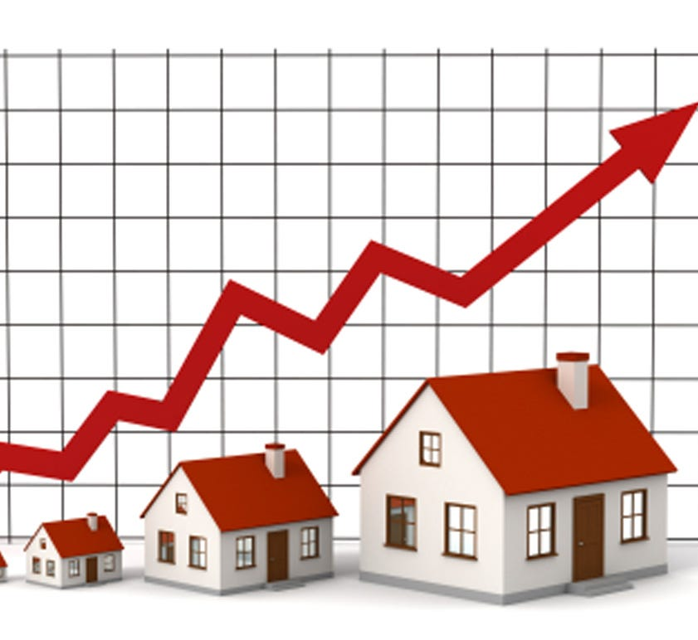
1. Define the problem
Problem Statement
Using example data, develop a model that predicts house prices based on the size of a house.

Slide 42
2 Get Data
Get Data
In this example we will be using a truncated version of the Ames dataset that only contains information on homes sold in May 2010.
About the Ames dataset
The Ames dataset is a widely available dataset that has become one of the standard datasets used when predicting home prices based on features of the home. It is based on the great work of Dean De Cock. His rational and insight into this dataset can be found at http://jse.amstat.org/v19n3/decock.pdf.
Getting the truncated dataset we use
This dataset can be found with the exercise files for this course. The filename is AmesHousing-05-2010.csv .

Slide 43
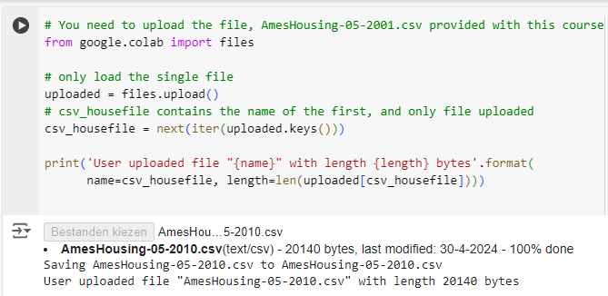
2 Get Data

Slide 44
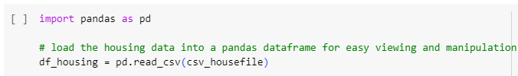
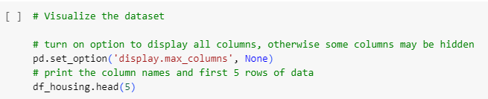
3. Prepare the data
Load the data into a pandas dataframe
Pandas let's us easily review and manipulate the data (*).
Visualize the House Price data
We use panda's head method to look at the first few rows of data. This will give us an understanding of the data we are working with.
* If you are new to pandas, see https://pandas.pydata.org/ and the pandas 10 minute intro http://pandas.pydata.org/pandas-docs/stable/getting_started/10min.html to understand how pandas, and pandas dataframes makes working with tabular data in Python easy.

Slide 45
3. Prepare the data
Lots of feature columns. From documentation of previous work with this data we can account for most of the difference in price (SalePrice) based on the size of the house.
Looking through the columns we see the following features contains square feet ('SF'): BsmtFin SF 1, BsmtFin SF 2, Bsmt Unf SF, Total Bsmt SF, 1st Flr SF, 2nd Flr SF, Low Qual Fin SF.
little more checking of the data and we see in the data that there are summary columns for the basement square footage and the above basement square footage. Specifically the feature columns Total Bsmt SF and Gr Liv Area sum the space as follows:
Total Bsmt SF = BsmtFin SF 1 + BsmtFin SF 2 + Bsmt Unf SF
Gr Liv Area = 1st Flr SF + 2nd Flr SF
But, there is no feature for the total space in the house which is the sum of Basement and Upper floors or (Total Bsmt SF + Gr Liv Area ).

Slide 46
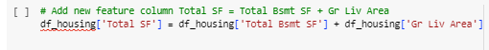
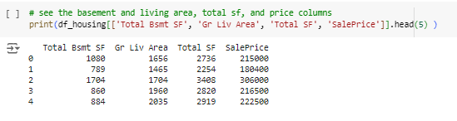
3. Prepare the data
We need to add the new column Total SF.
And we can check that the numbers add and see associated sale price

Slide 47
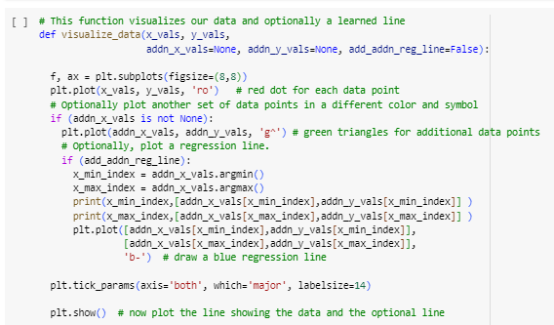
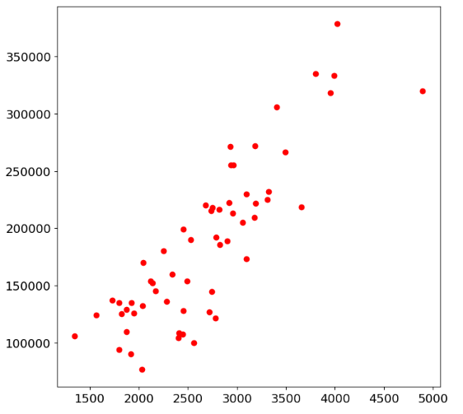
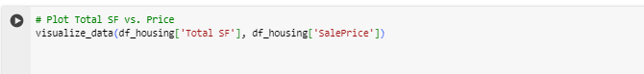
4. Prepare the data : Visualize the data.
We visualize the data to give us some idea of the relationships between the various features. To do that we create a function to plot the data.
Notes:
What does the visualization tell us?
There seems to be a linear relationship between the size of the house (as shown in Total SF) and Price.
This suggests that we should perform Linear Regression. Where the relationship in the data is: y = mx + b. Or in our case, Price = m * Total SF + b
With respect to defining the appropriate equation, we can see the difference between traditional programming and Machine Learning as:
In tradition programming we define what the equation is through structures such as conditional statements
In Machine Learning, our model learns from the data what the appropriate equation is.

Slide 48
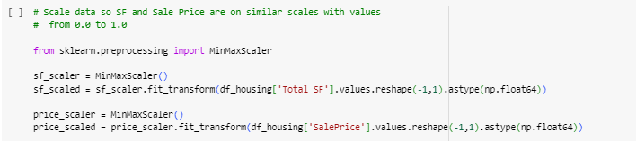
4. Prepare the data : scaling
If values are on very different scales it will be difficult for the model to determine the relationships between features. With our data, Square Footage (SF) ranges from 800-4200, and Prices range from 80,000 to 400,0000. This means there is a nearly 100 times difference in scale. When we normalize we will reduce both qualtities to the same scale while preserving the differences between prices and sizes of homes. This will help our model learn the relationship between price and size.

Slide 49
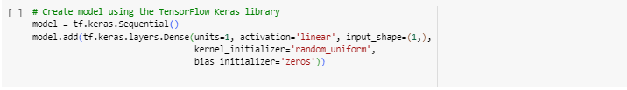
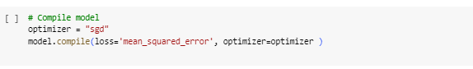
4. Create the model
We create our linear model using TensorFlow's Keras library. Using Keras makes it easy for us to create, train, and evaluate our model.

Slide 50
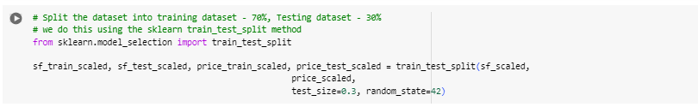
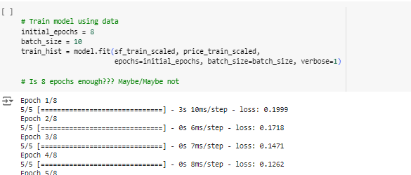
5. Train the model
Once the model has been defined and compiled we can train the model. We do this with training data.
We want to split our prepared dataset into 2 datasets. One dataset will be used for training, and the other dataset will used for testing. We never used testing data for training or training data for testing.
Notes:
We pass the training data through the model multiple times. On each pass, the loss function (that we defined in the model compile) will be used to calculate loss. And the optimizer will be used to make adjustments to the weights and bias (just called weights from here on) to minimize this error.
We repeat this process of calculating the loss with the current weights and updating the weights to minimize loss for the specified number of epochs. We should see the loss decrease over time.
We can set the verbose flag to tell Keras how much information to show during the training process, 0 is none, 1 and 2 show more in-progress information.

Slide 51
5. Train the model
Once the model has been defined and compiled we can train the model. We do this with training data.
We want to split our prepared dataset into 2 datasets. One dataset will be used for training, and the other dataset will used for testing. We never used testing data for training or training data for testing.
Notes:
We pass the training data through the model multiple times. On each pass, the loss function (that we defined in the model compile) will be used to calculate loss. And the optimizer will be used to make adjustments to the weights and bias (just called weights from here on) to minimize this error.
We repeat this process of calculating the loss with the current weights and updating the weights to minimize loss for the specified number of epochs. We should see the loss decrease over time.
We can set the verbose flag to tell Keras how much information to show during the training process, 0 is none, 1 and 2 show more in-progress information.

Slide 52


6. Evaluate the model
Once we have the model trained, we want to test with data not used to train the model!!!
The use of data not used in training to test the model is key. If you use training data our testing results will be overly accurate and will not reflect real-life usage of the trained model to make predictions.

Slide 53
Basic Computer vision with ML
Teaching a computer how to see and recognize different objects

Slide 54

How many shoes do you see ?
Two Right ?
But how do you know they are shoes ?
Notes:
Imagine if someone had never seen shoes before. How would you tell them that despite of the great difference between an high heel and sport shoe, they are still both shoes. If that person only gets the input that the high heel and de sport shoe are shoes he could assume that they are classsified as shoes because they are Red (they have only see those two as an example – bias). But of course it is not that simple.

Slide 55

Because in your life you have seen lots of shoes, and you have learned to understand what makes a shoe a shoe.
Notes:
Because in your life you’ve seen lot of shoes. So lets show the computer lots of shoes and it will learn to recognize what a shoe is.

Slide 56


Let’s have a look at the dataset called Fashion MNIST
Fashion MNIST
70 K Images
10 Categories
Images are 28 x 28 pixels
Can train a neural net because items are recognizable
Including 7000 shoes ☺
Let’s have a look at the code to train the computer ☺
Fashion MNIST
Notes:
Including 7000 shoes.
Images 28 x 28 pixel, but the less data the faster it is for a computer to process it.
Ok lets have a look at the code to train the computer ☺

Slide 57
lets have a look at the code to train the computer ☺
In the previous exercise you saw how to create a neural network that figured out the problem you were trying to solve. This gave an explicit example of learned behavior. Of course, in that instance, it was a bit of overkill because it would have been easier to write the function Y=3x+1 directly, instead of bothering with using Machine Learning to learn the relationship between X and Y for a fixed set of values, and extending that for all values.
Let's start with our import of TensorFlow
import tensorflow as tf
print(tf.__version__)

Slide 58

Loading the Fasion Minst Data
The Fashion MNIST data is available directly in the tf.keras datasets API. You load it like this:
mnist = tf.keras.datasets.fashion_mnist
Calling load_data on this object will give you two sets of two lists, these will be the training and testing values for the graphics that contain the clothing items and their labels.
(training_images, training_labels), (test_images, test_labels) = mnist.load_data()
9

Slide 59

If you don’t believe me … try this code
Let's print a training image, and a training label to see...Experiment with different indices in the array. For example, also take a look at index 42...that's a a different boot than the one at index 0
import matplotlib.pyplot as plt
plt.imshow(training_images[0])
print(training_labels[0])
print(training_images[0])
Pixel Values index 0
[ 0 0 0 0 0 0 0 0 0 0 0 0 0 0 0 0 0 0 0 0 0 0 0 0 0 0 0 0]
[ 0 0 0 0 0 0 0 0 0 0 0 0 0 0 0 0 0 0 0 0 0 0 0 0 0 0 0 0]
[ 0 0 0 0 0 0 0 0 0 0 0 0 0 0 0 0 0 0 0 0 0 0 0 0 0 0 0 0]
[ 0 0 0 0 0 0 0 0 0 0 0 0 1 0 0 13 73 0 0 1 4 0 0 0 0 1 1 0]
[ 0 0 0 0 0 0 0 0 0 0 0 0 3 0 36 136 127 62 54 0 0 0 1 3 4 0 0 3]
[ 0 0 0 0 0 0 0 0 0 0 0 0 6 0 102 204 176 134 144 123 23 0 0 0 0 12 10 0]
[ 0 0 0 0 0 0 0 0 0 0 0 0 0 0 155 236 207 178 107 156 161 109 64 23 77 130 72 15]
[ 0 0 0 0 0 0 0 0 0 0 0 1 0 69 207 223 218 216 216 163 127 121 122 146 141 88 172 66]
[ 0 0 0 0 0 0 0 0 0 1 1 1 0 200 232 232 233 229 223 223 215 213 164 127 123 196 229 0]
[ 0 0 0 0 0 0 0 0 0 0 0 0 0 183 225 216 223 228 235 227 224 222 224 221 223 245 173 0]
[ 0 0 0 0 0 0 0 0 0 0 0 0 0 193 228 218 213 198 180 212 210 211 213 223 220 243 202 0]
[ 0 0 0 0 0 0 0 0 0 1 3 0 12 219 220 212 218 192 169 227 208 218 224 212 226 197 209 52]
[ 0 0 0 0 0 0 0 0 0 0 6 0 99 244 222 220 218 203 198 221 215 213 222 220 245 119 167 56]
[ 0 0 0 0 0 0 0 0 0 4 0 0 55 236 228 230 228 240 232 213 218 223 234 217 217 209 92 0]
[ 0 0 1 4 6 7 2 0 0 0 0 0 237 226 217 223 222 219 222 221 216 223 229 215 218 255 77 0]
[ 0 3 0 0 0 0 0 0 0 62 145 204 228 207 213 221 218 208 211 218 224 223 219 215 224 244 159 0]
……….
index 0
index 42

Slide 60
Let’s normalize the data
You'll notice that all of the values in the number are between 0 and 255. If we are training a neural network, for various reasons it's easier if we treat all values as between 0 and 1, a process called 'normalizing'...and fortunately in Python it's easy to normalize a list like this without looping. You do it like this:
training_images = training_images / 255.0
test_images = test_images / 255.0
Now you might be wondering why there are 2 sets...training and testing -- remember we spoke about this in the intro? The idea is to have 1 set of data for training, and then another set of data...that the model hasn't yet seen...to see how good it would be at classifying values. After all, when you're done, you're going to want to try it out with data that it hadn't previously seen!
Notes:
Overfitting a model

Slide 61
Let's now design the model
Size of our image
model = tf.keras.models.Sequential([tf.keras.layers.Flatten(input_shape=(28,28)),
tf.keras.layers.Dense(128, activation=tf.nn.relu),
tf.keras.layers.Dense(10, activation=tf.nn.softmax)])
Number of cat.
Notes:
Overfitting a model

Slide 62

Let's now design the model
model = tf.keras.models.Sequential([tf.keras.layers.Flatten(input_shape=(28,28)),
tf.keras.layers.Dense(128, activation=tf.nn.relu),
tf.keras.layers.Dense(10, activation=tf.nn.softmax)])
F0
F0
F0
F127
= 9
Notes:
Overfitting a model

Slide 63
Let's now design the model
If x>0 {
return x;
}
Else {
return 0;
}
model = tf.keras.models.Sequential([tf.keras.layers.Flatten(input_shape=(28,28)),
tf.keras.layers.Dense(128, activation=tf.nn.relu),
tf.keras.layers.Dense(10, activation=tf.nn.softmax)])
0,02
0,01
0,02
0,01
0,05
0,01
0,08
0,02
0,01
9,78
0
0
0
0
0
0
0
0
0
1
Notes:
Overfitting a model

Slide 64

Training the model
model.compile(optimizer = tf.keras.optimizers.Adam(),
loss = 'sparse_categorical_crossentropy',
metrics=['accuracy'])
model.fit(training_images, training_labels, epochs=5)
Once it's done training -- you should see an accuracy value at the end of the final epoch. It might look something like 0.8918. This tells you that your neural network is about 91% accurate in classifying the training data. I.E., it figured out a pattern match between the image and the labels that worked 90% of the time. Not great, but not bad considering it was only trained for 5 epochs and done quite quickly.
Notes:
Overfitting a model

Slide 65
Training the model
model.compile(optimizer = tf.keras.optimizers.Adam(),
loss = 'sparse_categorical_crossentropy',
metrics=['accuracy'])
model.fit(training_images, training_labels, epochs=5)
Once it's done training -- you should see an accuracy value at the end of the final epoch. It might look something like 0.8918. This tells you that your neural network is about 90 % accurate in classifying the training data. I.E., it figured out a pattern match between the image and the labels that worked 90% of the time. Not great, but not bad considering it was only trained for 5 epochs and done quite quickly.
Notes:
Overfitting a model

Slide 66
But how would it work on unseen data ?
But how would it work with unseen data? That's why we have the test images. We can call model.evaluate, and pass in the two sets, and it will report back the loss for each. Let's give it a try:
model.evaluate(test_images, test_labels)
For me, that returned a accuracy of about .8739, which means it was about 88% accurate. As expected it probably would not do as well with unseen data as it did with data it was trained on!
Predictions = model.predict(my_images)
Notes:
Overfitting a model

Slide 67

And that is all it takes to teach a computer how to see and recognize images …
Images are always grayscale 28 x 28
Item of clothing centered
What if it’s just a normal photograph and we need to recognize its contents, and you don’t have the luxury of it being the only thing in the picture ….
The answer my friend is … spotting features using the tool of convolutional neural networks.
Notes:
Overfitting a model

Slide 68
Introducing convolutional neural networks
Filter images before training the neural network, to make sure that features come to the forefront

Slide 69
What is a filter ?
0
64
128
Current pixel value = 192
48
192
144
Consider neighbor values
142
226
168
-1
0
-2
Filter values
,5
4,5
-1,5
1,5
2
-3
Current pixel value = 192
New pixel value = (-1 * 0) + (0 * 64) + (-2 * 128) +
(0,5 * 48) + (4,5 * 192) + (-1,5 * 144) +
(1,5 * 42) + (2 * 226) + (-3 * 168)

Slide 70


Some examples to explain the benefits.
-1
0
1
-2
0
2
-1
0
1
Removes almost everything except the horizontal lines

Slide 71
Pooling
Pooling groups the Pixels in the image and filters them down to a subset
For example, max pooling two by two
Take Max Value
0
64
Group 2 X 2
192
48
192
0
64
128
128
128
128
Regroup
144
48
192
144
144
144
144
192
144
142
226
168
0
255
168
142
226
255
0
0
64
255
255
0
168
0
168
0
64
The image will be reduced to a quoter of its original size, but the features can still be maintained

Slide 72


The result after being filtered and Max pooled
Max pooling 2 X 2
The image on the right is one quarter of the right
But the vertical line features were maintained and enhanced

Slide 73

Overview

Slide 74



Where do these filters come from ?
Dense
Output
Notes:
Where do these filters come from :
That is the magic of connvulutional neural network, They are actually learned. They are just parameters like those in the neurtrons in an neural network. So as our image is fed into the convelutional layer a number of random initialliezed filters will pass over the image. The results of these are fed into the next layer and matching is performed by the neural network. And over time the filters that give the image output that give the best matches will be learned. That process is called feature extraction.
In any Neural Network, first layer will be input layer and last will be the output layer. Input layer contains all the inputs, here images is inputs. These images are given as input to the first convolutional layer. The output of 1st layer will be given as input to the 2nd layer, so on & so forth. This process will continue till the last layer.

Slide 75

Example convolutional filter layer
The shoe is filtered down to the silhouette

Slide 76
Let’ have a look at the code
Same as before but we haven’t defined an input layer … yet
model = tf.keras.models.Sequential([
tf.keras.layers.Flatten(),
tf.keras.layers.Dense(128, activation='relu’),
tf.keras.layers.Dense(10, activation='softmax')
])
Let’s put a convolutional layer on top of this
Apply 64 filters
Defining the input shape
model = tf.keras.models.Sequential([
tf.keras.layers.Conv2D(64, (3, 3), activation='relu’
,input_shape=(28, 28, 1)),
tf.keras.layers.MaxPooling2D(2, 2),
tf.keras.layers.Flatten(),
tf.keras.layers.Dense(128, activation='relu’),
tf.keras.layers.Dense(10, activation='softmax')
])
Max pooling to compress the image
Notes:
It will generate 64 filters and multiply each of them across the image
Each epoch will figure out which filters gave the best signal to help match the images to the labels, in the same way it learned which parameters worked best in the dense layer
Max pooling to enhance the features …

Slide 77
You can stack convolutional layers on top of each other
model = tf.keras.models.Sequential([
tf.keras.layers.Conv2D(32, (3, 3), activation='relu', input_shape=(28, 28, 1)),
tf.keras.layers.MaxPooling2D(2, 2),
#Add another convolution
tf.keras.layers.Conv2D(64, (3,3), activation='relu'),
tf.keras.layers.MaxPooling2D(2, 2),
#Now flatten the output. After this you'll just have the same DNN structure as the non convolutional version
tf.keras.layers.Flatten(),
#The same 128 dense layers, and 10 output layers as in the pre-convolution example:
tf.keras.layers.Dense(128, activation='relu'),
tf.keras.layers.Dense(10, activation='softmax')
])
Notes:
You stack convolutional layers to break down the image and try to learn from very abstract features eg. Two sleeves is a shirt, two short sleeves it is a T-shirt. Sole and laces it’s a shoe …
For the moment we are still looking at simple images of fashion but principles can be applied into more complex images

Slide 78
Build an image classifier
Building of an image classifier for rock, paper, and scissors

Slide 79
Data and Labels
Data
Data
Data
10001100101111010101100100110000100011001110011110010100101010001011100011100110
10001100101111010101100100110000100111011001010010101000101111000101001111100110
111000111100111100001010100100000101001100011101100010111001001110001111110011001
Label = Scissors
Label = Rock
Label = Paper
Notes:
Remener this

Slide 80

What have we learned so far
We discussed how difficult it might be to write a program that could recognize hands of different shapes, sizes, ethnicities, and more for something as simple as rock, paper, scissors.
But since then, we've becoming machine learning experts! Learned how to build neural networks, first to detect patterns in raw pixels and then detect features using convolutions.
Let's put it all together and train a model that can detect and spot rock, paper, and scissors.
Notes:
Now let’s build a neural network that is trained on rock, paper and scissors to detect and spot them

Slide 81


Download the zipfiles containing that data
Training set
Test / validation set
To unzip
in Google Colab, the /tmp directory is a temporary storage location within the virtual environment provided by Colab. Similarly, for other cloud services, it would be within the virtual instance or container you are using.

Slide 82
How does it look like ?
The previous command creates folders with sub-folders of each of our categories.
tmp
rps
Rock
rock06ck02-038.png
rock02-041.png
rock07-k03-029.png
...
Paper
paper07-074.png
paper01-117.png
paper01-002.png
...
Scissors
scissors03-054.png
scissors02-069.png
scissors04-079.png
Labels
...
Unzipping them creates folders and sub-folders of each of our categories. When training in TensorFlow using an image data generator, we will automatically label the images based on the name of their parent directory. So, we don't need to create labels for the images, a really nice shortcut.

Slide 83


ImageDataGenerator to automatically label images
This creates an image data generator that generates images for the training from the directory that they were downloaded, too. We can do exactly the same for test set

Slide 84

The neural network definition
You can see that our input is now 150x150
And our output is a layer of three neurons. Why ?
Because there are three classes:
rock, paper, and scissors.
4 Layers of Convolutions
Each with MaxPooling
Notes:
This is very like what you saw before just with more layers.
One reason is that the images are more complicated than the grayscale clothing we saw previously and another is that they're bigger.
You can see that our input is now 150x150. Our images are certainly bigger than they were before.
And our output is a layer of three neurons.
Because there are three classes: rock, paper, and scissors.

Slide 85


Compile and execute …

Slide 86

Training and Validation accuracy

Slide 87
Synthetic Data
Synthetic data generated from computer simulations or algorithms provides an inexpensive alternative to real-world data that’s increasingly used to create accurate AI models

Slide 88

https://www.youtube.com/watch?v=NrmMk1Myrxc

Slide 89

There’s a grey area in artificial intelligence filled with millions of humans who work in secret — they’re often hired to train algorithms but end up operating much of their work instead. These crucial workers took the spotlight this week when The Information reported that Amazon’s Just Walk Out technology, which allowed customers to grab grocery items from a shelf and walk out of the store, was being phased out of its grocery stores. It partially relied on more than 1,000 people in India who were watching and labeling videos to make sure the checkouts were accurate.

Slide 90


Slide 91

USE case virtual fish will tell us how healthy our fishing grounds
This project by ILVO - Flanders Research Institute for Agriculture, Fisheries and Food - aims to check how healthy fish stocks are and how much can be caught without putting pressure on the stocks.
By using machine vision and deep learning techniques the analysis of what is caught by the Belgian fishing industry can be widen. Currently seagoing observers/researchers from ILVO, are limited in their capabilities aboard of the vessels.
challenges to overcome
To train the AI-driven image processing and optimize the AI-model, a large amount of annotated/labeled image data is required.
Say hello to synthetic data
You do not train the system on data from the real world, but on a simulation of it.
https://www.vintecc.com/en/cases/virtual-fish-will-tell-us-how-healthy-our-fishing-grounds-are
Notes:
'We started synthesizing plaice. It means that we generate as many digital variations as possible of that one fish, based on real data such as its texture, images of the different sides of the fish, the various shapes and sizes it can take...', says ILVO researcher Sam Vanhoorne.

Slide 92
Tip of the day
Flanders AI forum

Slide 93

https://www.flandersaiforum.be/

Slide 94
CGI Innovations
Idea Challenge – June 2024

Slide 95

CGI Innovations | Idea Challenge – June 2024
Starting June 24, 2024, submit your innovative ideas that apply AI to QA processes.
In today's fast-paced development landscape, with code increasingly generated by AI models, ensuring high-quality applications aligned with client expectations is crucial. This challenge explores novel ways of leveraging Artificial Intelligence (AI) technologies to enhance the Quality Assurance (QA) process.
The challenge invites creative thinkers, developers, and QA professionals to submit innovative ideas that can streamline and improve QA processes including: all phases of test case planning, test case creation, test execution, as well as data quality testing, performance testing, scalability testing, security testing, or new AI-related activities such as responsible use testing, model testing, red-teaming, black-swan testing, bias testing, or synthetic data quality testing. The goal is to find solutions that can reduce testing efforts, increase test coverage, and detect defects more efficiently, leading to higher-quality applications.
CGI Innovations

